Slide 1
The First Pitch Lesson

Slide 2




First Pitch Lessons
Strayed from the standard "10-slide-business-school-pitch-deck" and showed its product in action.
Everything an investor needs to know is within 10 snappy slides.
Solid data coupled with real-world anecdotes. Humble + powerful.
Wholly transparent as they were one of the first startups to post their deck online for all to see rather than keeping their cards close

Slide 3
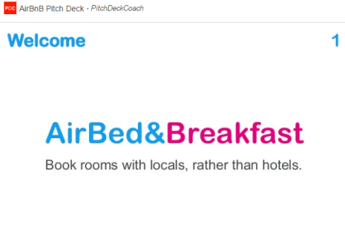
AirB&B – The First Pitch
The Big Idea

Slide 4
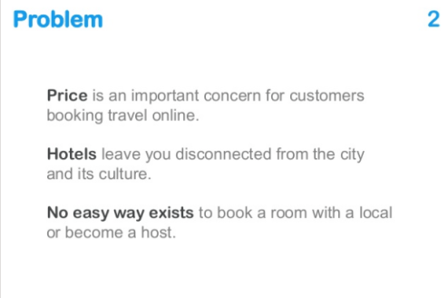
AirB&B – The First Pitch
Top Customer Pain Points

Slide 5
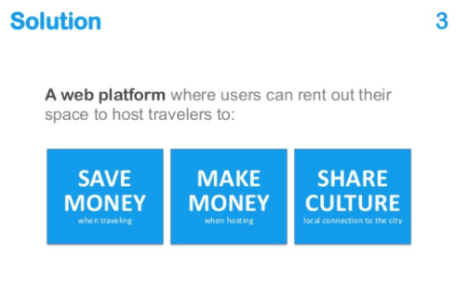
AirB&B – The First Pitch
Solution for Dummies

Slide 6
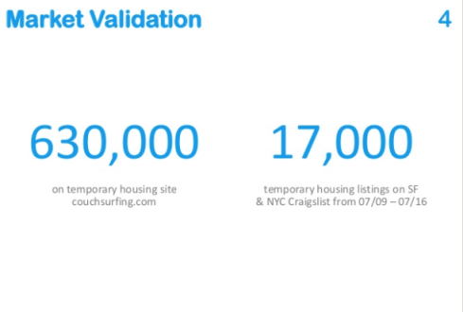
AirB&B – The First Pitch
The Market Numbers

Slide 7
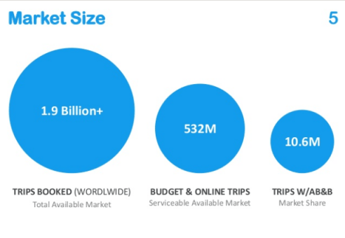
AirB&B – The First Pitch
Market Size and Share

Slide 8
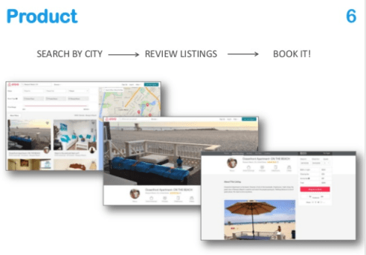
AirB&B – The First Pitch
Simple Product Explanation

Slide 9
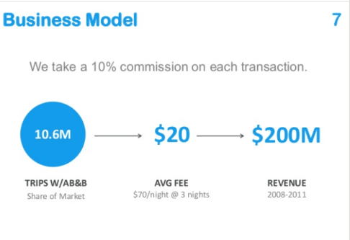
AirB&B – The First Pitch
Simplicity in numbers

Slide 10
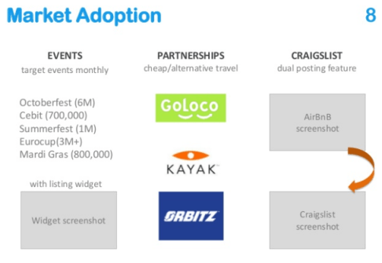
AirB&B – The First Pitch
Credibility

Slide 11
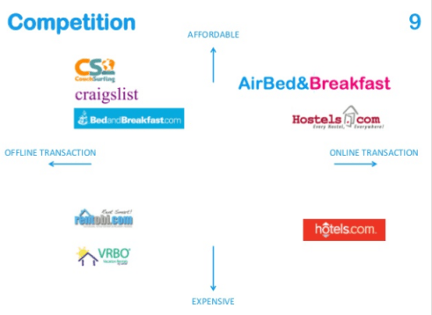
AirB&B – The First Pitch
Positioning

Slide 12
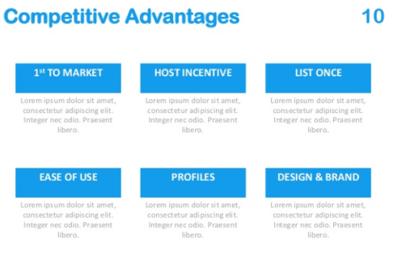
AirB&B – The First Pitch
Backup FirePower

